Slide 1

Vel Tech Rangarajan Dr. Sagunthala R&D Institute of Science and Technology
School of Computing
Department of Computer Science and Engineering
10211CS224 / FULL STACK APPLICATION DEVELOPMENT (JAVA)
END SEMESTER PROJECT REVIEW
Date: 06-05-2026
Full Stack Event Ticket Booking System
SDG: SDG No – SDG Title(Example: SDG 4 – Quality Education)
Presented By:
SHAIK SANHEERA– VTU26379 –23UECS1205
Courses Handling Faculty:
Dr. S. Manohar ME.,Phd
Assistant Professor

Slide 2
INTRODUCTION
1
This project is a dynamic, full-stack web application designed to streamline the process of discovering and booking tickets for various college events (Technical, Non-Technical, and Workshops).
It provides a seamless user experience for students to register, browse events, and secure their spots, while providing organizers with an automated way to manage ticket availability.
2
3
4
5
6
7
8
9

Slide 3
PROBLEM STATEMENT
1
2
Manual and Time - Consuming: Booking tickets requires manual work, which takes more time and slows down the process.
Long Queues : Users often stand in long lines, especially during peak times, causing inconvenience.
Poor Record Management: Maintaining records manually can lead to errors, data loss, and duplication.
Limited Accessibility : Booking is only available at specific places and times, reducing user convenience.
Difficulty in Tracking : Users cannot easily check ticket availability or booking status in real time.
Inefficient for Large Users : The system cannot handle a large number of users effectively during high demand.
Higher Chances of Errors : Manual data entry may lead to mistakes in booking details.
3
4
5
6
7
8
9

Slide 4
OBJECTIVE(S)
1
2
Objective 1:To develop an online platform that allows users to book tickets easily and quickly from anywhere at any time.
Objective 2:To reduce manual effort and waiting time by automating the ticket booking process.
Objective 3:To maintain and manage booking records efficiently with proper data storage and retrieval.
3
4
5
6
7
8
9

Slide 5
PROPOSED SYSTEM
Centralized Event Hub: Instead of relying on physical notice boards or scattered WhatsApp messages, the proposed system provides a single, unified dashboard where students can discover all upcoming Technical, Non-Technical, and Workshop events.
Real-Time Inventory Management: The system utilizes MongoDB to actively track ticket availability. When a student books a ticket, the available capacity decreases instantly, entirely eliminating the risk of overbooking or double-booking.
Secure User Authentication: Implementing JSON Web Tokens (JWT) and Bcrypt password hashing ensures that user data is highly protected. Only verified students can log in and perform sensitive actions like booking tickets.
Automated Ticket Generation: Upon successful registration for an event, the system automatically generates a digital receipt/ticket, providing instant confirmation to the user without any manual intervention from organizers.
Interactive & Responsive UI: Built with React and enhanced with Framer Motion animations, the system guarantees a smooth, modern, and mobile-friendly experience across all devices.
1
2
3
4
5
6
7
8
9

Slide 6
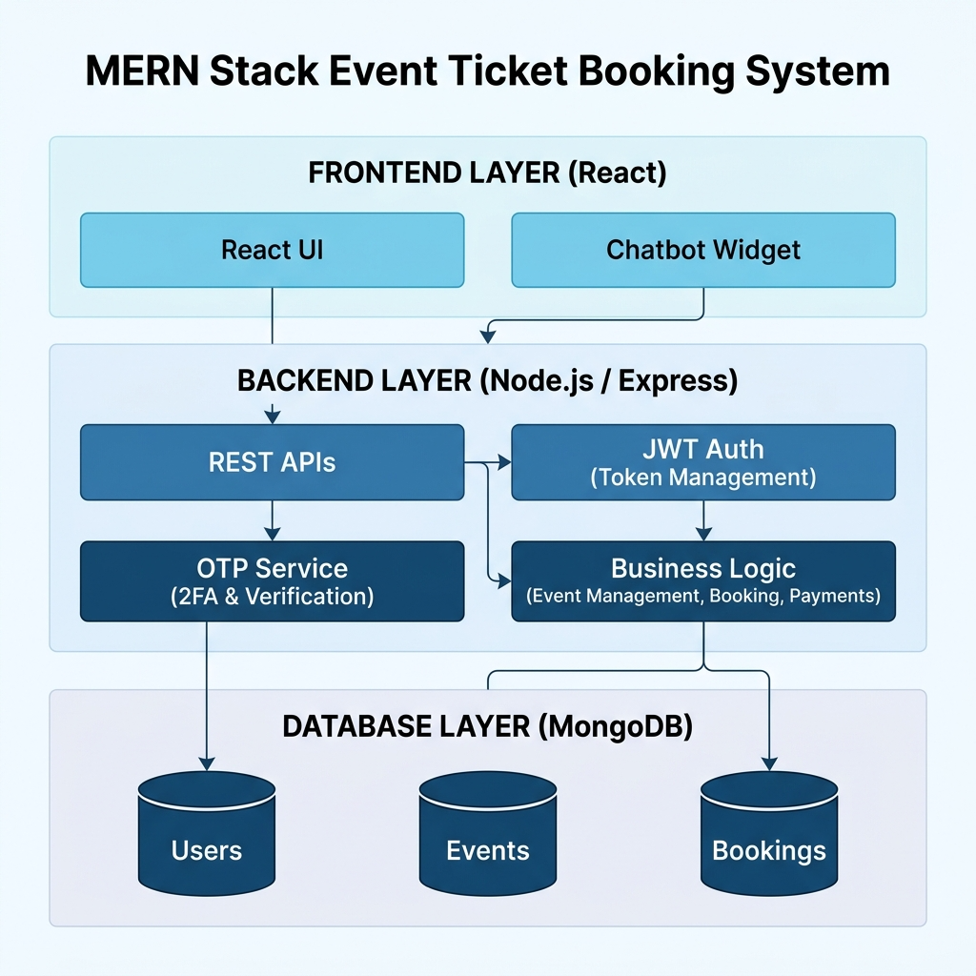
PROPOSED SYSTEM ARCHITECTURE
1
2
3
4
5
6
7
8
9

Slide 7
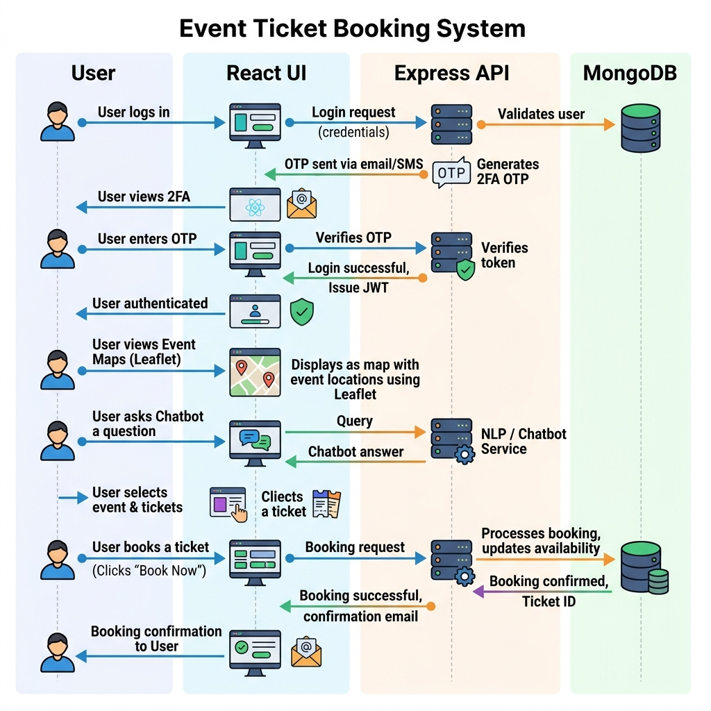
WORKFLOW
1
2
3
4
5
6
7
8
9

Slide 8
TECHNOLOGIES USED
1
Frontend: React JS, HTML5, CSS3,Javascript.
Backend: Node.js, Express.js, JWT for Authentication.
Database: Mongodb
Third-Party API:SMTP(used for sending the 2FA OTP codes to users)
Hardware Requirements:
Processor: Intel i3 or above
RAM: 4 GB or above
Operating System: Windows / Linux / macOS
Software Requirements: Node.js ,Npm, Web Browser (Chrome/Edge/Firefox)
2
3
4
5
6
7
8
9

Slide 9
MODULE DESCRIPTION
Module 1: User Management
Handles secure user registration, password hashing (using bcrypt), and authentication. It manages user sessions using JSON Web Tokens (JWT) to ensure only authorized users can book tickets or view their profiles.
Module 2: Core Processing
Implements the main business logic of the application. It fetches available events from the server, handles the ticket selection process, processes the booking requests, and updates ticket inventory in real-time.
Module 3: Database Management
Manages data storage and retrieval using MongoDB. It ensures data integrity across structured collections for Users, Events, Bookings, and temporary OTPs.
Module 4: Innovative Module
Incorporates advanced features to enhance security and user experience. This includes a secure Two-Factor Authentication (2FA) flow using Email OTP verification during login, and an automated rule-based Chatbot widget for instant customer support.
Module 5: Reporting & Analytics
Provides personalized insights for the user through the "My Bookings" dashboard, generating a historical visual report of all their past and upcoming purchased event tickets.
1
2
3
4
5
6
7
8
9

Slide 10
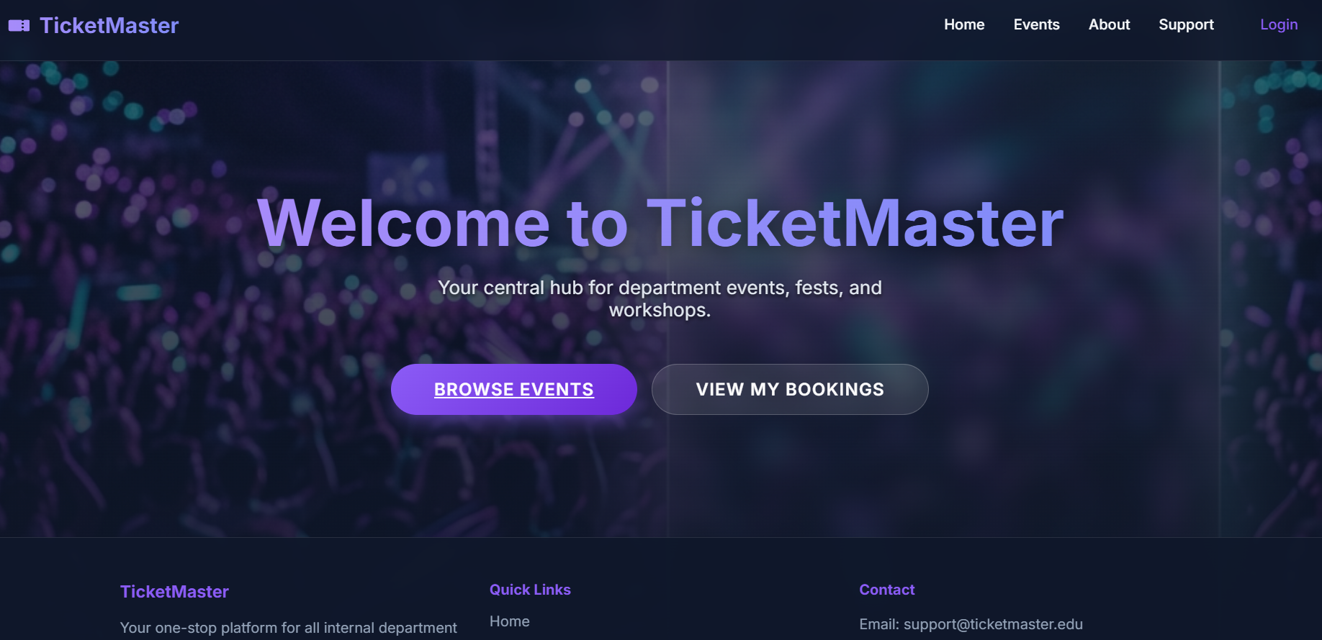
IMPLEMENTATION SCREENSHOTS
1
2
3
4
5
6
7
8(A)
9
Home page:
The user/admin can view the homepage where they cam browse events and see their bookings

Slide 11
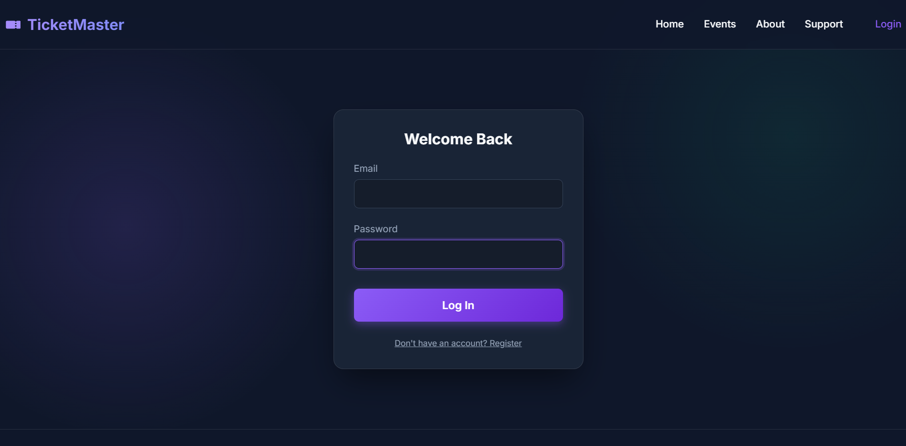
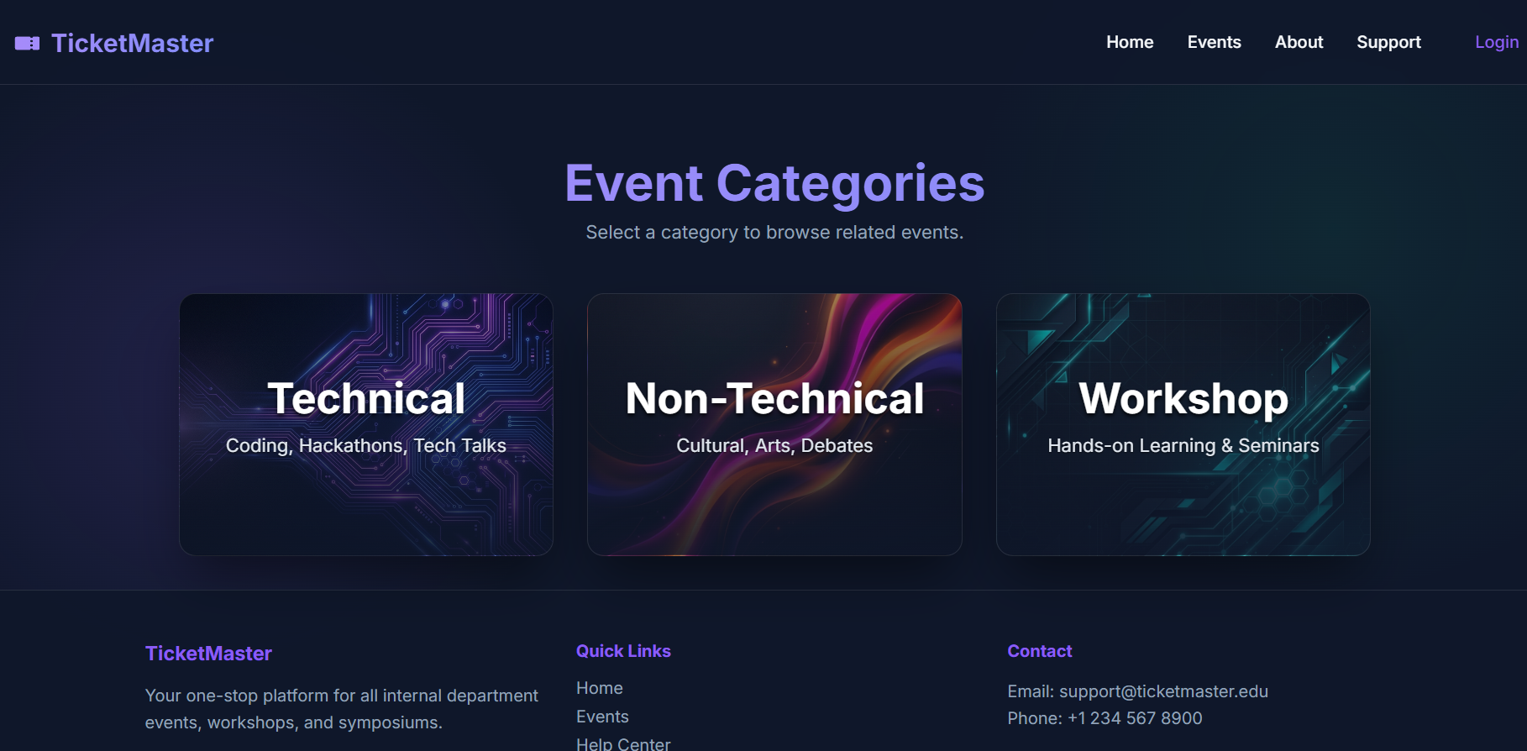
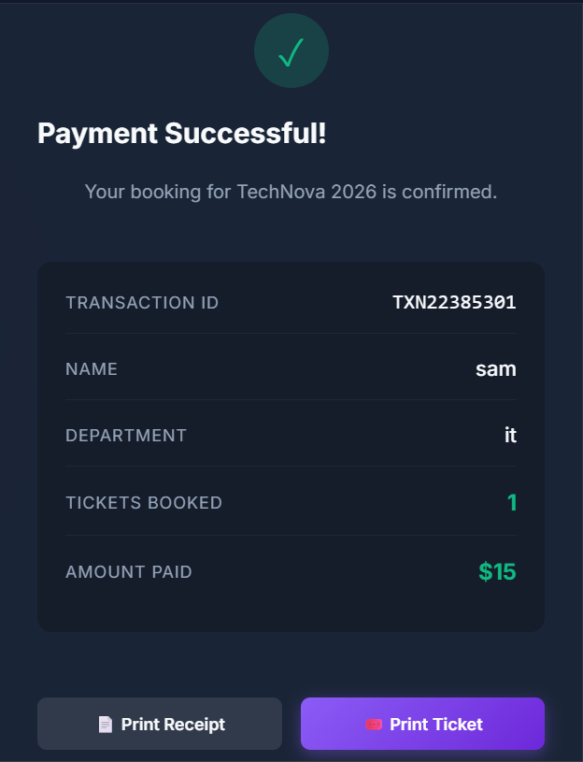
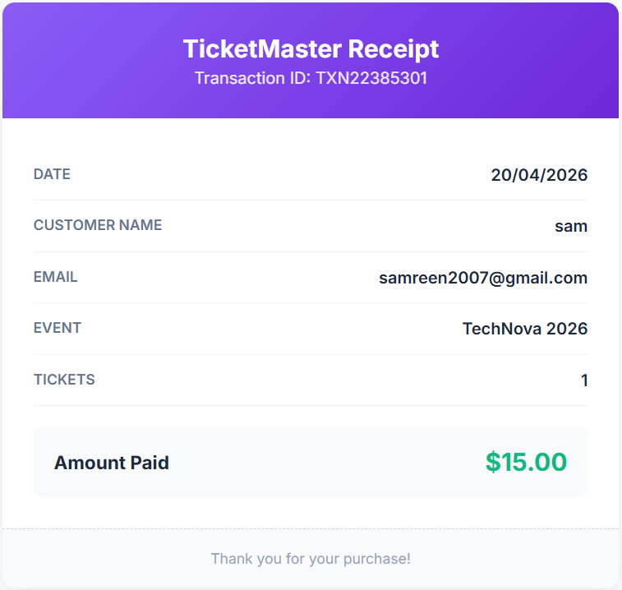
IMPLEMENTATION SCREENSHOTS
1
2
3
4
5
6
7
8
9

Slide 12
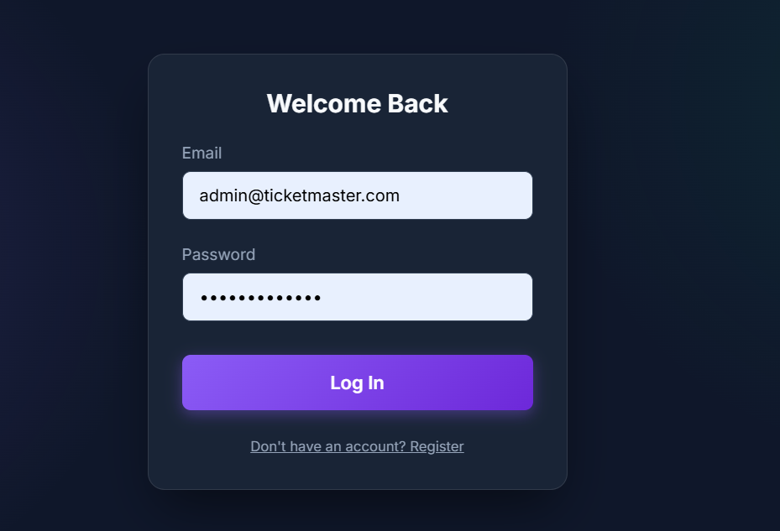
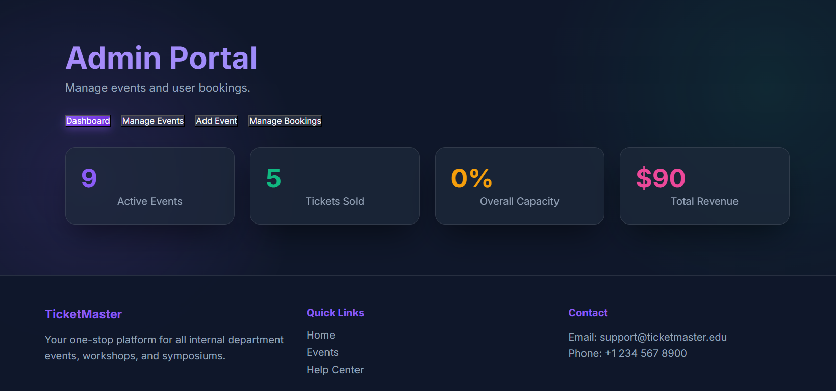
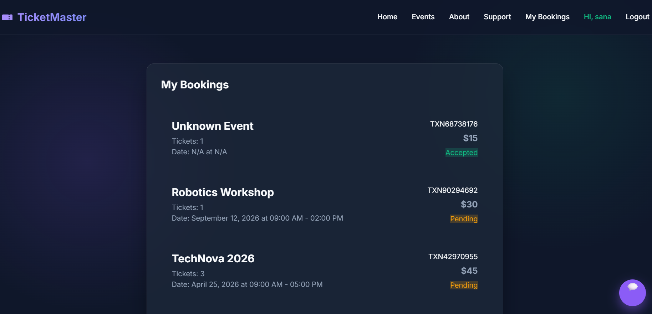
IMPLEMENTATION SCREENSHOTS
Admin Login Page
User Login Page
1
2
3
4
5
6
7
8(B)
9

Slide 13
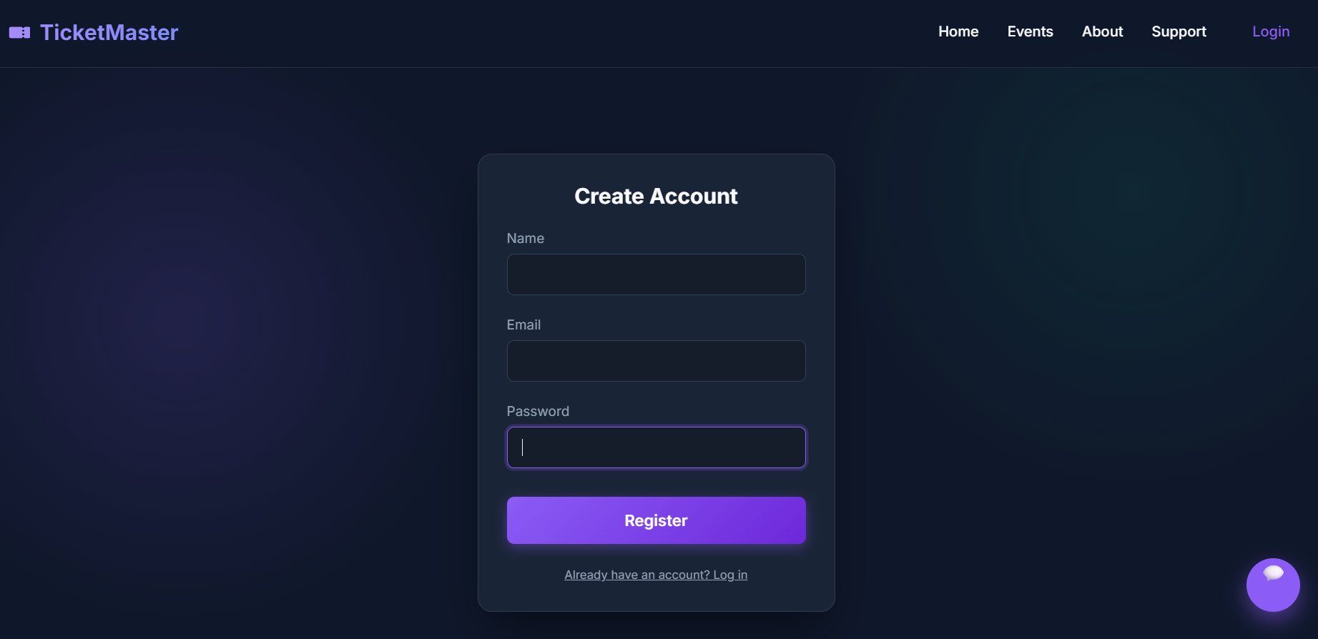
IMPLEMENTATION SCREENSHOTS
MODULE 1: User Management(Registration and Login Page)
.
1
2
Registration page:
Securely captures user credentials, ensuring passwords are encrypted before being stored in the database.
3
4
5
6
7
Login page:
The user can login to so that they can access the event tickets and bookings securely. And admin can login to manage events , bookings.
8(C)
9

Slide 14
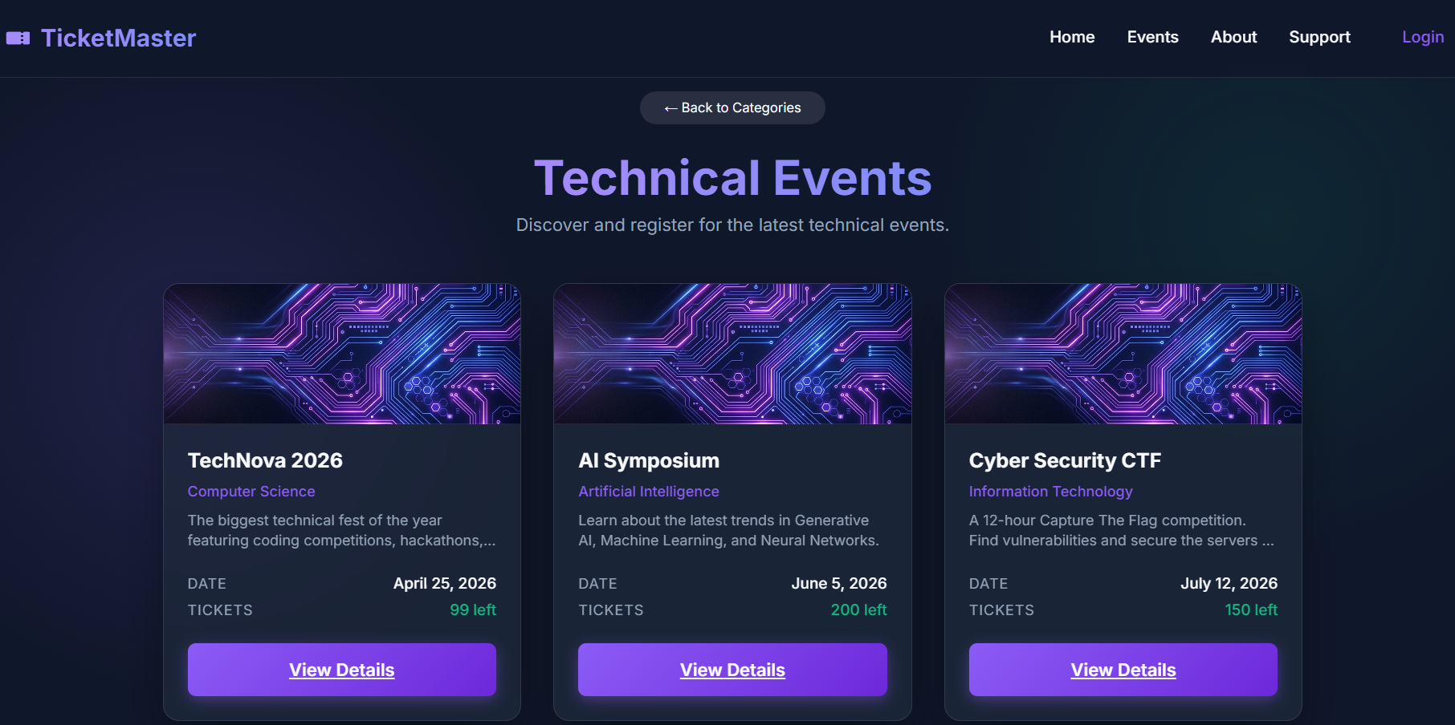
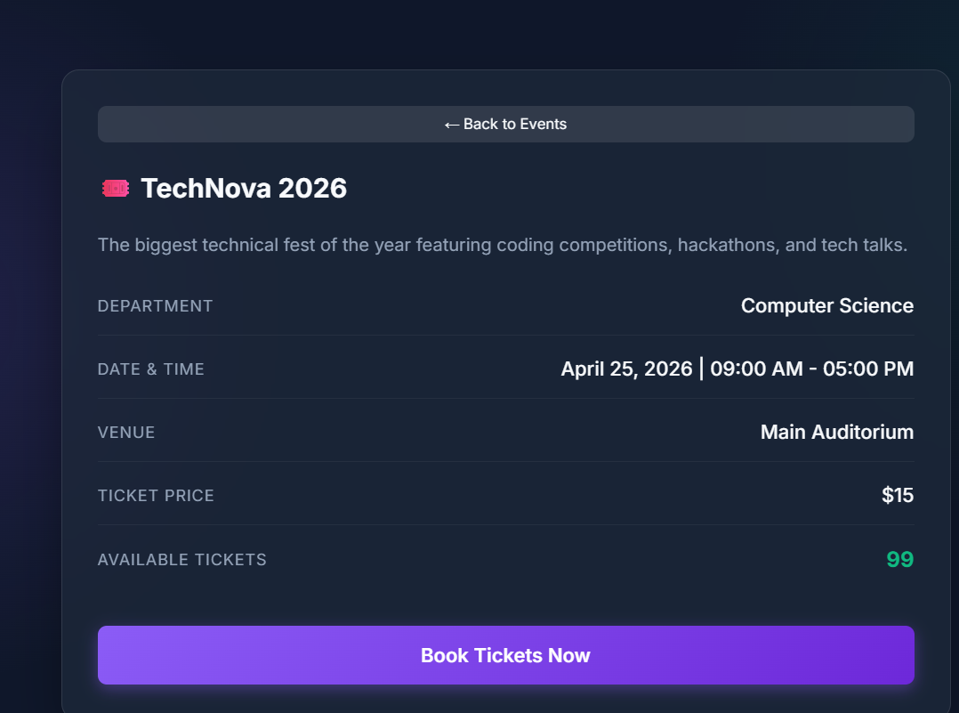
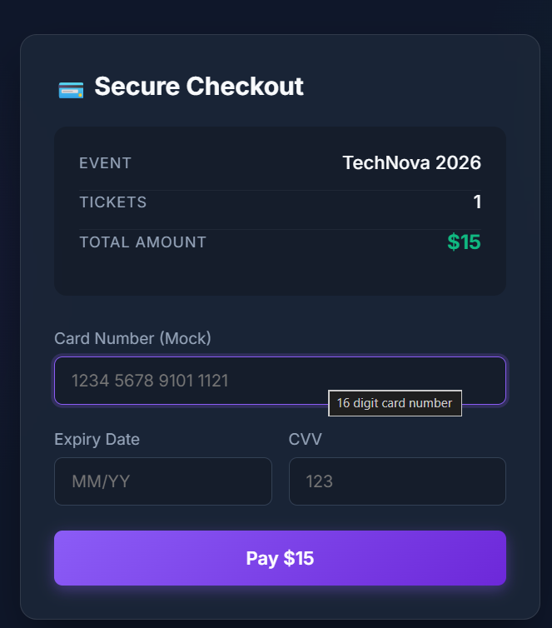
IMPLEMENTATION SCREENSHOTS
MODULE 2:Event Management and Booking(Event Details and Booking page)
1
2
3
4
5
6
7
8(C)
9

Slide 15
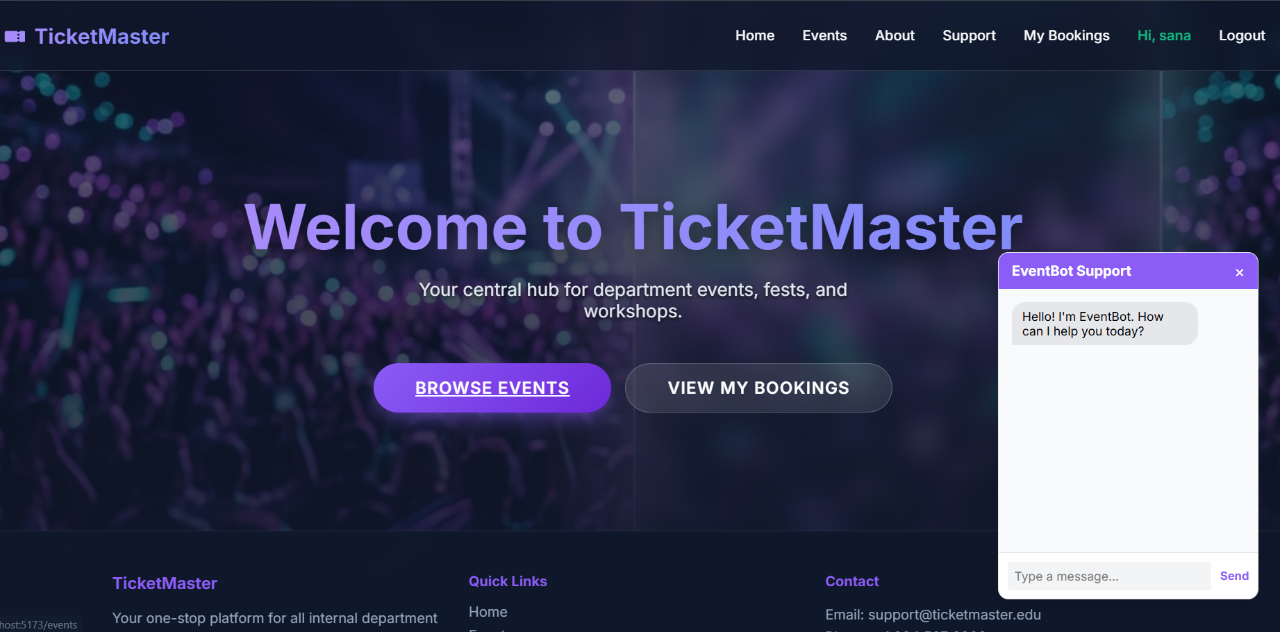
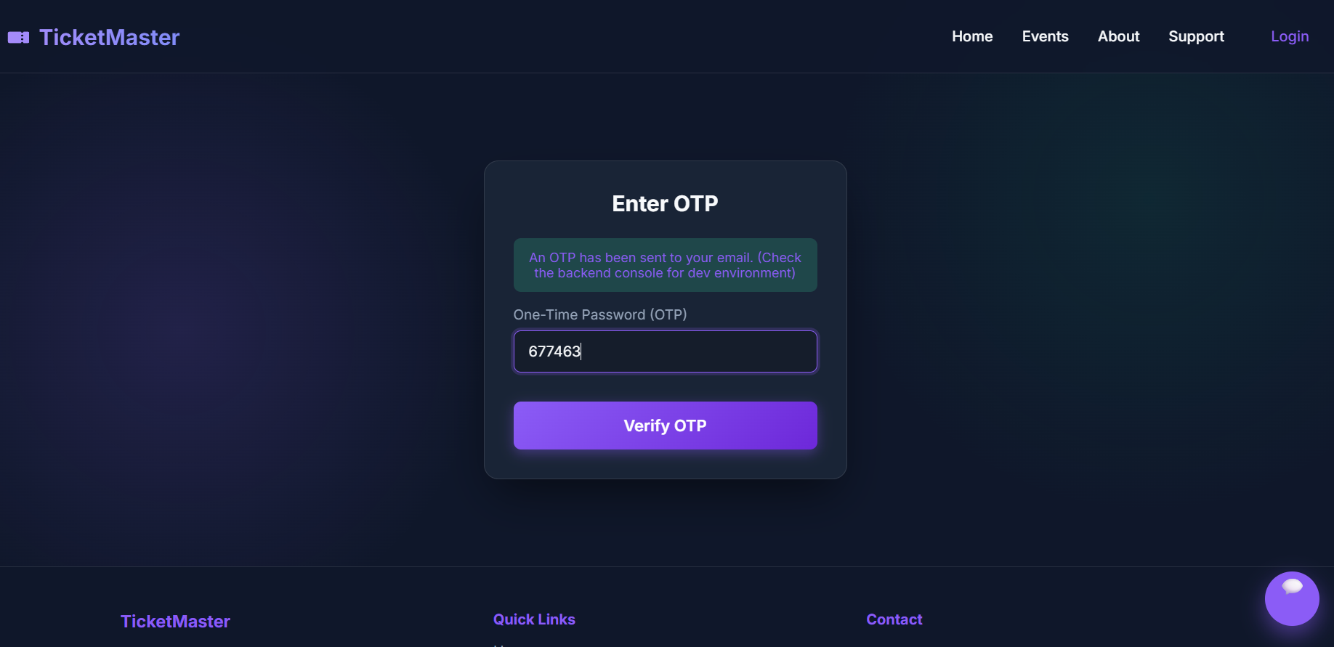
IMPLEMENTATION SCREENSHOTS
Innovation Module: (OTP verification &ChatBoInterface)
1
2
ChatBot Interface Page:
Integrates a rule-based automated assistant to provide users with instant, 24/7 customer support.
Improves overall user experience by quickly answering common questions about ticketing policies and events.
3
4
5
6
7
OTP Verification Page:
Adds an extra layer of security by requiring a One-Time Password sent to the user's email during login,prevents unauthorized access and protects user accounts even if their primary password is compromised.
8(C)
9

Slide 16
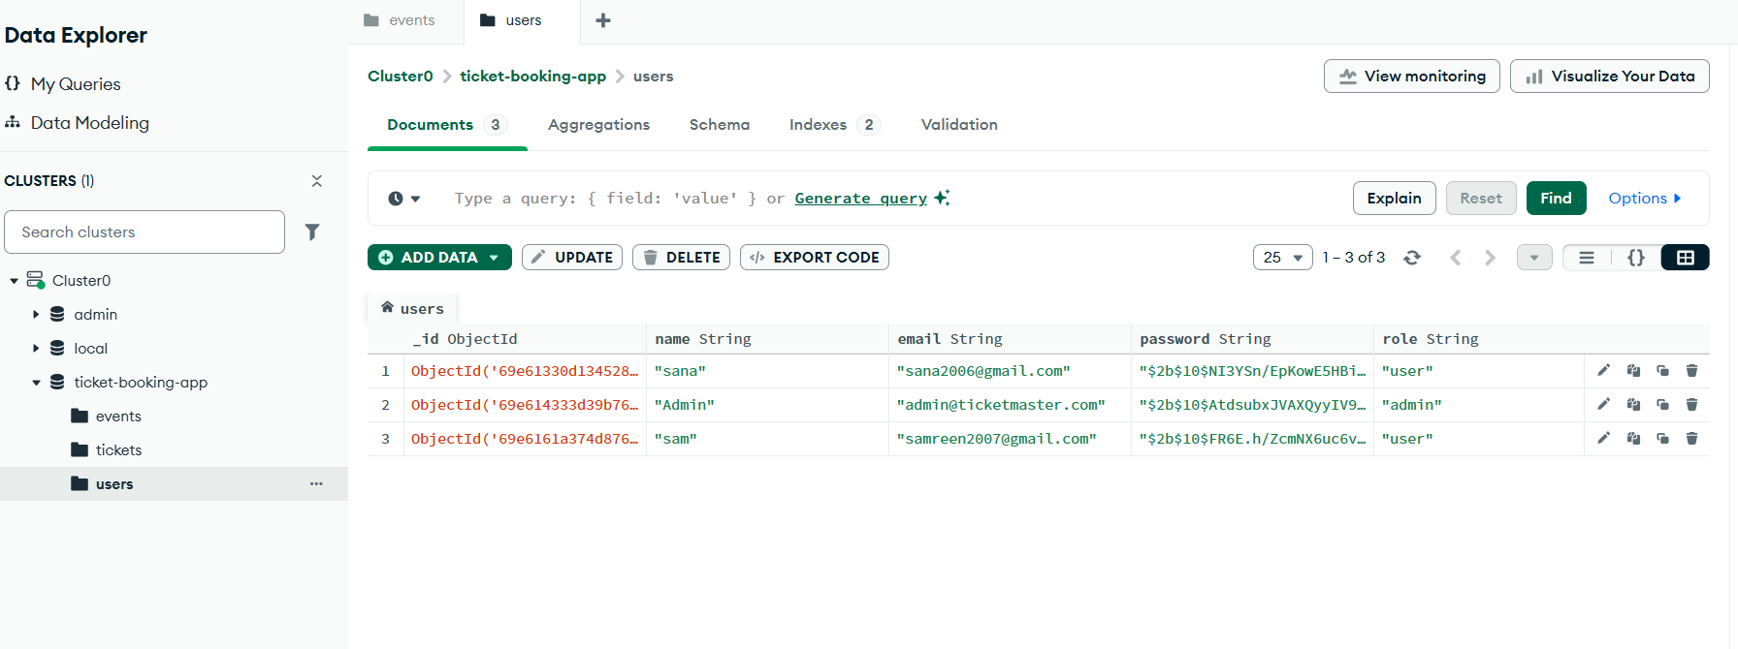
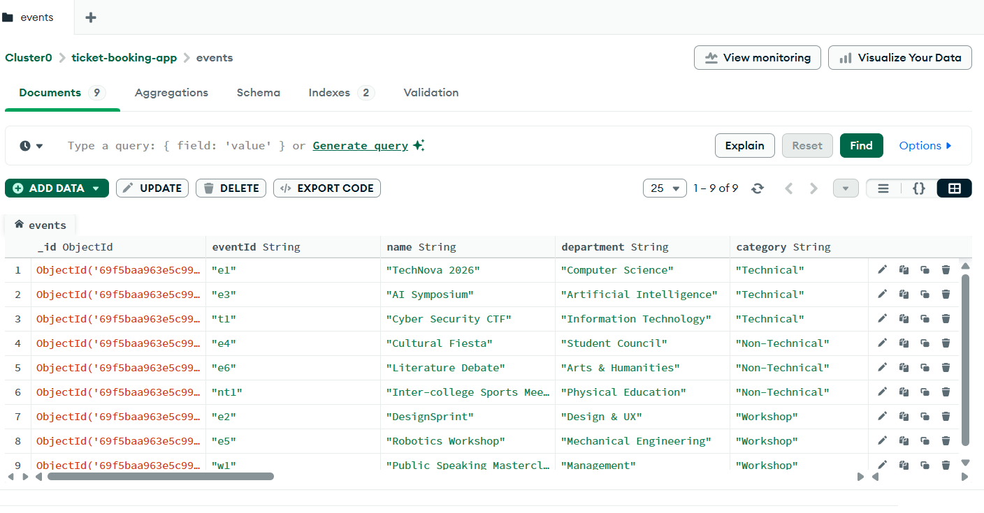
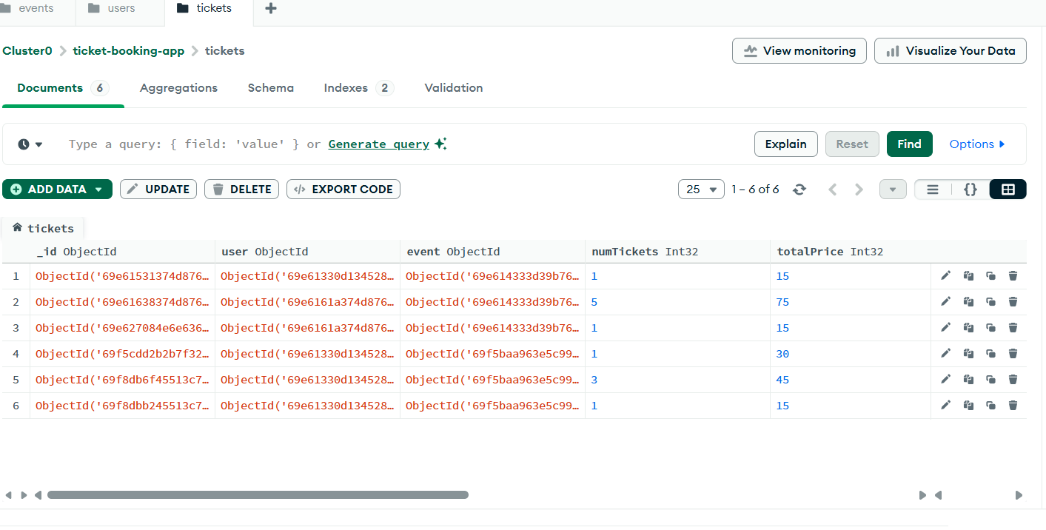
IMPLEMENTATION SCREENSHOTS
Database:
1
User table:
Displays a structured, real-time view of all registered users managed within the system's database, Ensures administrators can effectively monitor user accounts, roles, and securely hashed credentials.
2
3
4
5
6
7
8(C)
9
Events and booking tables:
Efficiently manages the complete ticketing lifecycle by maintaining comprehensive event details and tracking user reservations in real-time.

Slide 17
ADVANTAGES & LIMITATIONS
1
Advantages:
Enhanced Security: Protects user accounts with Two-Factor Authentication (2FA) via OTP and encrypts passwords using bcrypt.
24/7 Automated Support: The integrated chatbot provides instant answers to common user queries without requiring human intervention.
Highly Responsive UI: Built with React and Framer Motion, ensuring a smooth, dynamic, and fast user experience without page reloads.
Scalable Architecture: Uses MongoDB (NoSQL), allowing the database to easily scale and handle a growing number of events and bookings.
Limitations:
Rule-Based Chatbot Limits: The chatbot is programmed with predefined rules; it cannot understand complex, out-of-context natural language like a true AI.
Third-Party Dependency: The 2FA security relies on external SMTP/Email services to deliver the OTP. If the email server is down, users cannot log in.
Internet Requirement: The platform is entirely web-based and requires a stable internet connection to browse events or process bookings (no offline mode).
2
3
4
5
6
7
8
9

Slide 18
Thank you

